Slide 1


Caravel + Nucleo Board

Slide 2




Caravel Board V4 Block Diagram
USB Interface
Voltage Regulator
$5V$ Supply
$3.3V$ Supply
$1.8V$ Supply
Caravel BB
PoR
SPI
HKSPI/IO [1:4]
FTDI
$$\overline{RST}$$
Flash Memory
UART
Configure IOs
IO [5:6]
SPI Interface
SPI
IO [0:37]
UART Enable

Slide 3
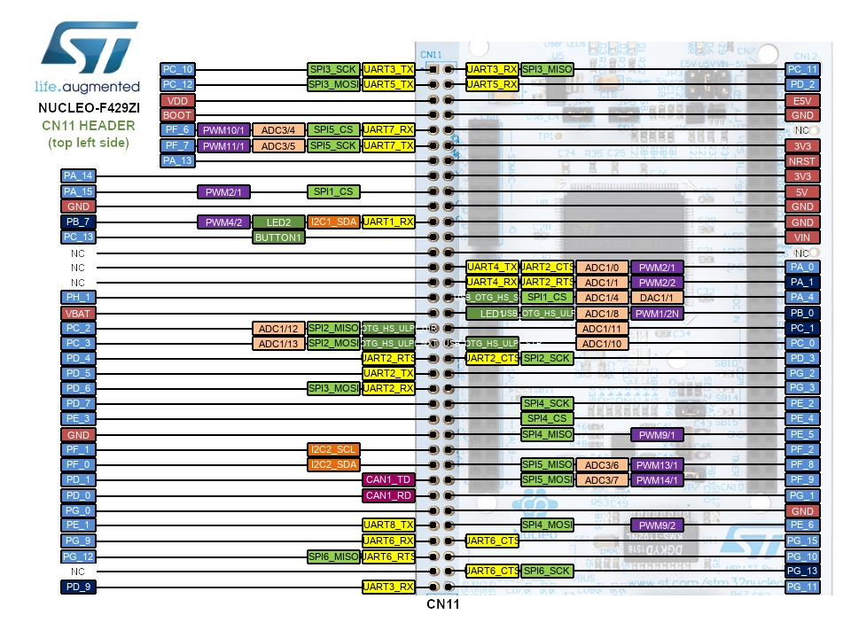
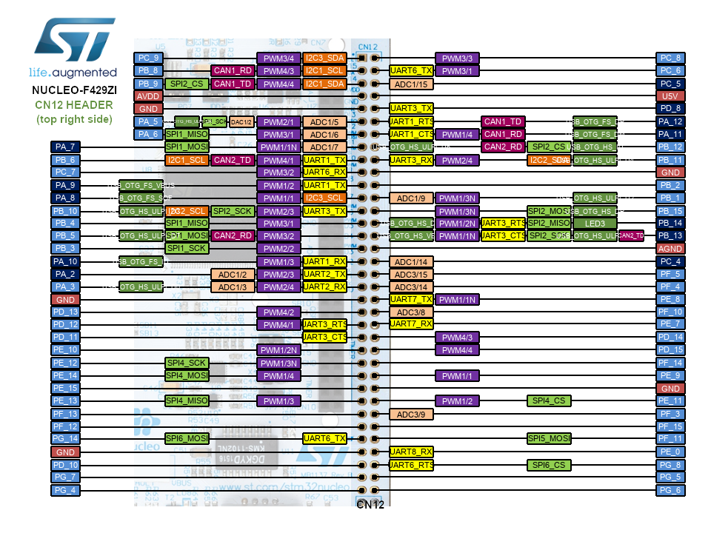
Nucleo Board: ST Morpho Connectors
[1]: https://os.mbed.com/platforms/ST-Nucleo-F429ZI/#board-pinout

Slide 4
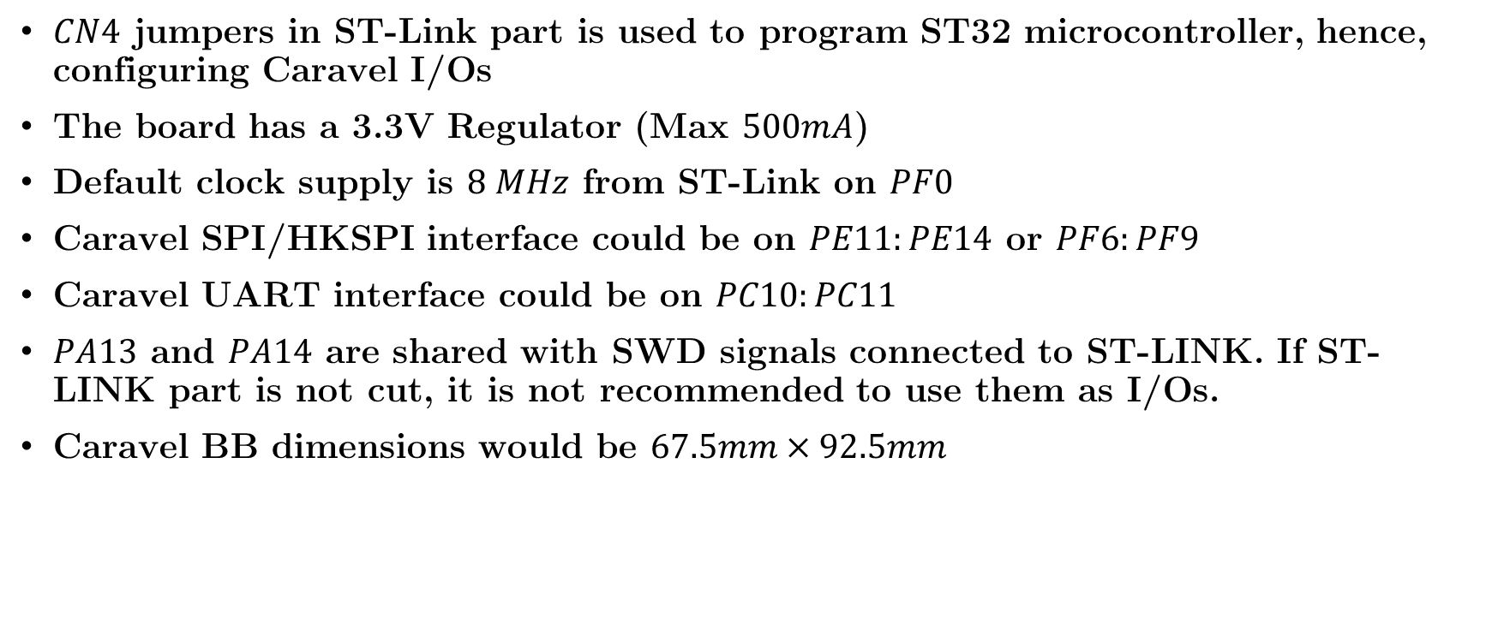
Nucleo Board: Interface with Caravel
$CN4$ jumpers in ST-Link part is used to program ST32 microcontroller, hence, configuring Caravel I/Os
The board has a 3.3V Regulator (Max $500mA$)
Default clock supply is $8 MHz$ from ST-Link on $PF0$
Caravel SPI/HKSPI interface could be on $PE11:PE14$ or $PF6:PF9$
Caravel UART interface could be on $PC10:PC11$
$PA13$ and $PA14$ are shared with SWD signals connected to ST-LINK. If ST-LINK part is not cut, it is not recommended to use them as I/Os.
Caravel BB dimensions would be $67.5mm×92.5mm$

Slide 5










Caravel + Nucleo Board Block Diagram
Nucleo-144 Board
USB Interface
$5V$ Supply
Voltage regulator
Adj Voltage regulator
$$1.8V$$
$$3.3V$$
$$V_{out1}$$
$$V_{out2}$$
Caravel Chip
USB Interface
ST-LINK
D-POT+R Network
$$V_{1.8}$$
$$I^{2}C$$
$$V_{3.3}$$
SPI Interface
ST Morpho Connectors
HKSPI/IO [1:4]
UART/IO [5:6]
$$\overline{RST}$$
$$CLK$$
IO [0:37]
Caravel BB

Slide 6









Caravel + Nucleo Board Block Diagram
Nucleo-144 Board
USB Interface
Caravel mainboard
$$I^{2}C$$
Voltage Regulator
Adj Voltage regulator
$5V$ Supply
USB Interface
$$1.8V$$
$$3.3V$$
$$V_{out1}$$
$$V_{out2}$$
$$V_{1.8}$$
Caravel BB
D-POT+R Network
$$V_{3.3}$$
SPI
FTDI
HKSPI/IO [1:4]
$$\overline{RST}$$
PoR
UART
IO [5:6]
SPI
Flash Memory
SPI Interface
IO [0:37]
UART Enable
ST Morpho Connectors

Slide 7
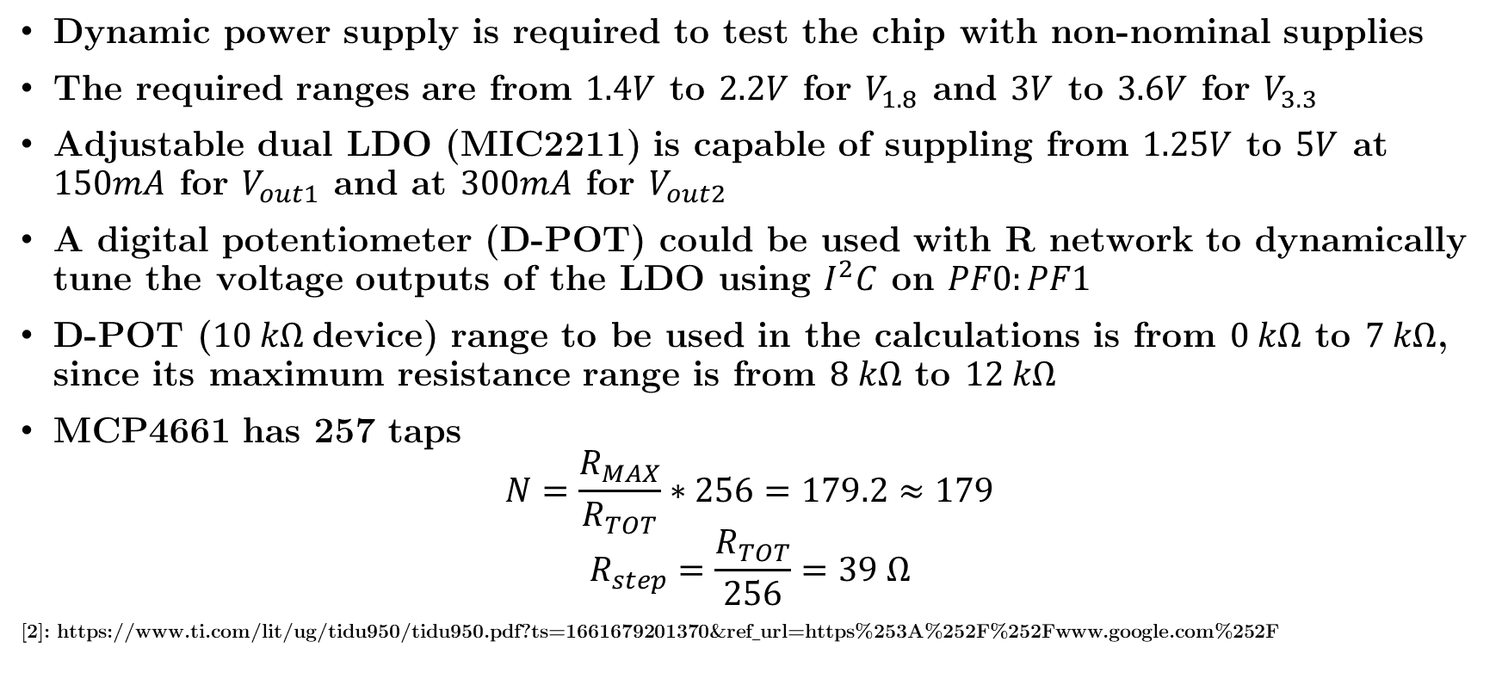
Dynamic Voltage Scaling (DVS)
Dynamic power supply is required to test the chip with non-nominal supplies
The required ranges are from $1.4V$ to $2.2V$ for $V_{1.8}$ and $3V$ to $3.6V$ for $V_{3.3}$
Adjustable dual LDO (MIC2211) is capable of suppling from $1.25V$ to $5V$ at $150mA$ for $V_{out1}$ and at $300mA$ for $V_{out2}$
A digital potentiometer (D-POT) could be used with R network to dynamically tune the voltage outputs of the LDO using $I^{2}C$ on $PF0:PF1$
D-POT ($10 kΩ$device) range to be used in the calculations is from $0 kΩ$ to $7 kΩ$, since its maximum resistance range is from $8 kΩ$ to $12 kΩ$
MCP4661 has 257 taps
$$N=\frac{R_{MAX}}{R_{TOT}}∗256=179.2≈179$$
$$R_{step}=\frac{R_{TOT}}{256}=39 Ω$$
[2]: https://www.ti.com/lit/ug/tidu950/tidu950.pdf?ts=1661679201370&ref_url=https%253A%252F%252Fwww.google.com%252F

Slide 8




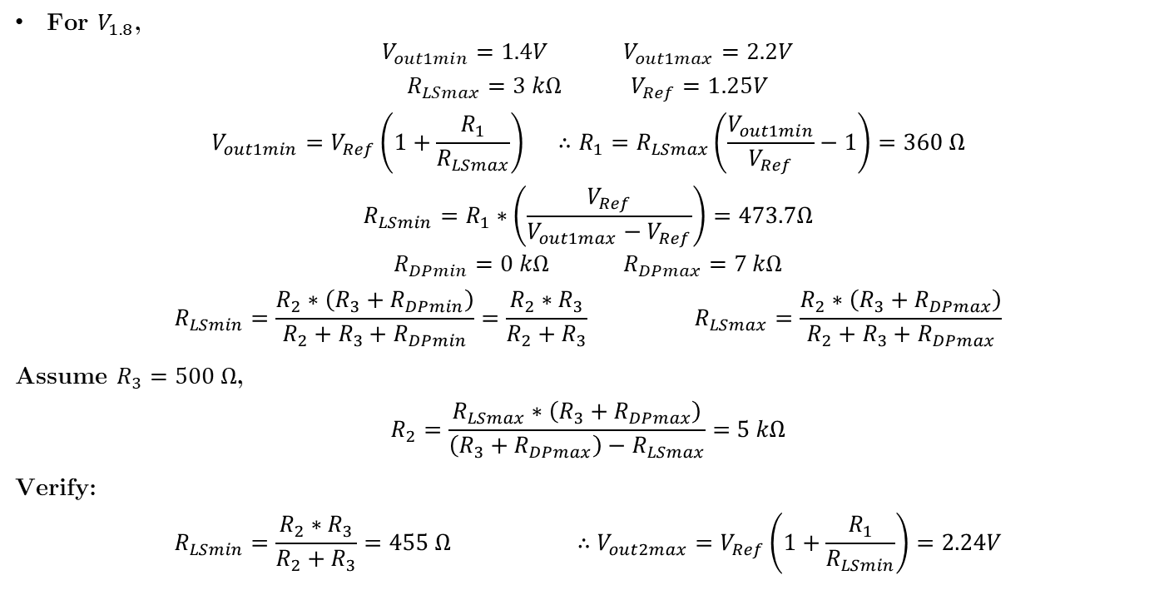



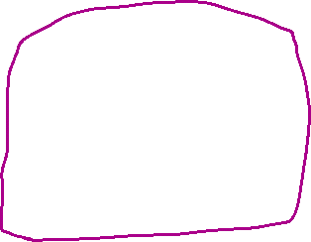
Resistance Calculations
For $V_{1.8}$,
$$V_{out1min}{=1.4V} V_{out1max}{=2.2V}$$
$$R_{LSmax}{=3 kΩ} V_{Ref}{=1.25V}$$
$$V_{out1min}{=V_{Ref}\left(1+\frac{R_{1}}{R_{LSmax}}\right) ∴R_{1}=R_{LSmax}\left(\frac{V_{out1min}}{V_{Ref}}−1\right)=360 Ω}$$
$$R_{LSmin}=R_{1}∗\left(\frac{V_{Ref}}{V_{out1max}−V_{Ref}}\right)=473.7Ω$$
$$R_{DPmin}{=0 kΩ}{ R}_{DPmax}{=7 kΩ}$$
$$R_{LSmin}=\frac{R_{2}∗\left(R_{3}+R_{DPmin}\right)}{R_{2}+R_{3}+R_{DPmin}}=\frac{R_{2}∗R_{3}}{R_{2}+R_{3}} R_{LSmax}=\frac{R_{2}∗\left(R_{3}+R_{DPmax}\right)}{R_{2}+R_{3}+R_{DPmax}}$$
Assume $R_{3}=500 Ω$,
$$R_{2}=\frac{R_{LSmax}∗\left(R_{3}+R_{DPmax}\right)}{\left(R_{3}+R_{DPmax}\right)−R_{LSmax}}=5 kΩ$$
Verify:
$$R_{LSmin}=\frac{R_{2}∗R_{3}}{R_{2}+R_{3}}=455 Ω ∴V_{out2max}{=V_{Ref}\left(1+\frac{R_{1}}{R_{LSmin}}\right)=2.24V}$$
Notes:
$V_{Ref}$ is from the adjustable dual LDO (MIC2211) datasheet
$R_{LSmax}$ is set to ensure loop stability, not sure of the basis of this value

Slide 9
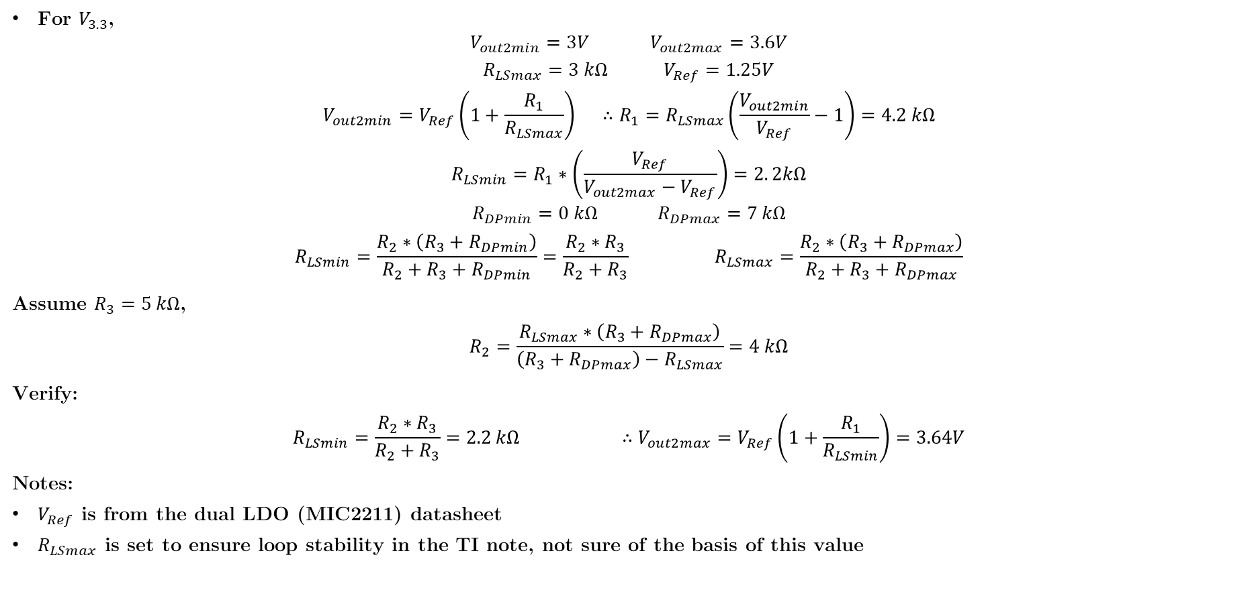
Resistance Calculations
For $V_{3.3}$,
$$V_{out2min}{=3V} V_{out2max}{=3.6V}$$
$$R_{LSmax}{=3 kΩ} V_{Ref}{=1.25V}$$
$$V_{out2min}{=V_{Ref}\left(1+\frac{R_{1}}{R_{LSmax}}\right) ∴R_{1}=R_{LSmax}\left(\frac{V_{out2min}}{V_{Ref}}−1\right)=4.2 kΩ}$$
$$R_{LSmin}=R_{1}∗\left(\frac{V_{Ref}}{V_{out2max}−V_{Ref}}\right)=2. 2kΩ$$
$$R_{DPmin}{=0 kΩ}{ R}_{DPmax}{=7 kΩ}$$
$$R_{LSmin}=\frac{R_{2}∗\left(R_{3}+R_{DPmin}\right)}{R_{2}+R_{3}+R_{DPmin}}=\frac{R_{2}∗R_{3}}{R_{2}+R_{3}} R_{LSmax}=\frac{R_{2}∗\left(R_{3}+R_{DPmax}\right)}{R_{2}+R_{3}+R_{DPmax}}$$
Assume $R_{3}=5 kΩ$,
$$R_{2}=\frac{R_{LSmax}∗\left(R_{3}+R_{DPmax}\right)}{\left(R_{3}+R_{DPmax}\right)−R_{LSmax}}=4 kΩ$$
Verify:
$$R_{LSmin}=\frac{R_{2}∗R_{3}}{R_{2}+R_{3}}=2.2 kΩ ∴V_{out2max}{=V_{Ref}\left(1+\frac{R_{1}}{R_{LSmin}}\right)=3.64V}$$
Notes:
$V_{Ref}$ is from the dual LDO (MIC2211) datasheet
$R_{LSmax}$ is set to ensure loop stability in the TI note, not sure of the basis of this value

Slide 10

Resistance Calculations
For nominal supplies:
$$V_{out1}{=1.8V} V_{out2}{=3.3V}$$
$$R_{LS}={R_{1}∗\left(\frac{V_{Ref}}{{V_{out}−V}_{Ref}}\right)}$$
$${∴R}_{LS1}=818.2 Ω {∴R}_{LS2}=2.6 kΩ$$
$$R_{LS}=\frac{R_{2}∗\left(R_{3}+R_{DP}\right)}{R_{2}+R_{3}+R_{DP}} ∴R_{DP}=\frac{R_{LS}∗\left(R_{2}+R_{3}\right)−R_{2}R_{3}}{R_{2}−R_{LS}}$$
$${∴R}_{DP1}=478 Ω {∴R}_{DP2}=2. 4kΩ$$
$$R_{DP}=\frac{R_{TOT}N}{256}+R_{W} ∴N=\left(R_{DP}−R_{W}\right)∗\frac{256}{R_{TOT}}$$
$$R_{W}=75 Ω { R}_{TOT}=10 kΩ$$
$${∴N}_{1}=10.3≈11 \left(Bh\right) {∴N}_{2}=59.5≈60 (3Ch)$$

Slide 11
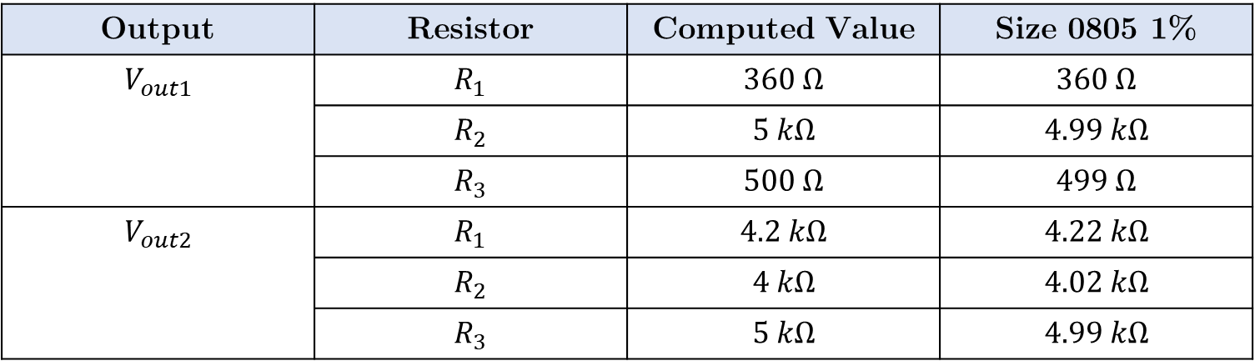
Resistors Components
Output | Resistor | Computed Value | Size 0805 1%
$$V_{out1}$$ | $$R_{1}$$ | $$360 Ω$$ | $$360 Ω$$
 | $$R_{2}$$ | $$5 kΩ$$ | $$4.99 kΩ$$
 | $$R_{3}$$ | $$500 Ω$$ | $$499 Ω$$
$$V_{out2}$$ | $$R_{1}$$ | $$4.2 kΩ$$ | $$4.22 kΩ$$
 | $$R_{2}$$ | $$4 kΩ$$ | $$4.02 kΩ$$
 | $$R_{3}$$ | $$5 kΩ$$ | $$4.99 kΩ$$
Notes:
MIC2211 datasheet recommends that to prevent low quiescent current performance being compromised Resistor values are between 100kΩ and 500kΩ. This can’t be achieved with the $R_{LSmax}$ assumption

Slide 12
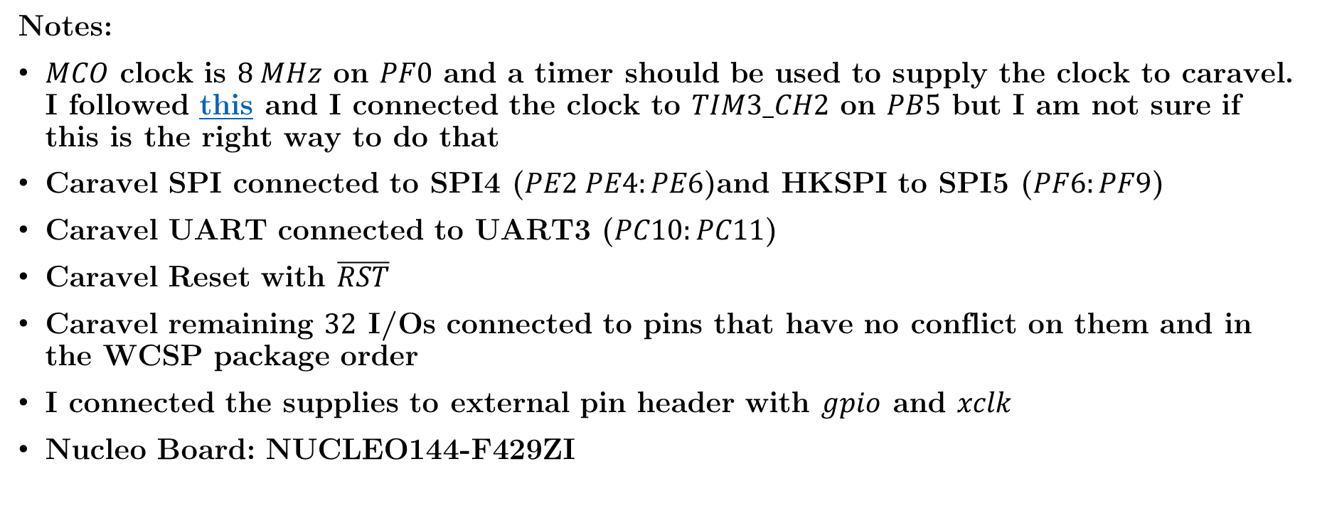
Caravel + Nucleo Board Schematic
Notes:
$MCO$ clock is $8 MHz$ on $PF0$ and a timer should be used to supply the clock to caravel. I followed this and I connected the clock to $TIM3_CH2$ on $PB5$ but I am not sure if this is the right way to do that
Caravel SPI connected to SPI4 ($PE2 PE4:PE6$)and HKSPI to SPI5 ($PF6:PF9$)
Caravel UART connected to UART3 ($PC10:PC11$)
Caravel Reset with $\overline{RST}$
Caravel remaining $32$ I/Os connected to pins that have no conflict on them and in the WCSP package order
I connected the supplies to external pin header with $gpio$ and $xclk$
Nucleo Board: NUCLEO144-F429ZI

Slide 13
Caravel + Nucleo Pinout
Caravel BB Pin | ST Morpho Pin
1: io[37] | 98: PB15
2: io[36] | 96: PB1
3: io[35] | 94: PB2
4: io[34] | 89: PB6
5: GND | 88: PB12
6: vccd | -
7: vddio | -
8: GND | 75: PB8
9: io[33] | 88: PB12
10: io[32] | 77: PB9
11: io[31] | 76: PC6
12: io[30] | 75: PB8
13: io[29] | 74: PC8
14: io[28] | 73: PC9
Caravel BB Pin | ST Morpho Pin
15: io[27] | 4: PD2
16: io[26] | 13: PA13
17: io[25] | 15: PA14
18: io[24] | 17: PA15
19: io[23] | 28: PA0
20: io[22] | 32: PA4
21: io[21] | 35: PC2
22: io[20] | 37: PC3
23: io[19] | 38: PC0
24: io[18] | 39: PD4
25: io[17] | 40: PD3
26: io[16] | 41: PD5
27: io[15] | 42: PG2
28: io[14] | 43: PD6

Slide 14
Caravel + Nucleo Pinout
Caravel BB Pin | ST Morpho Pin
29: io[13] | 44: PG3
30: io[12] | 45: PD7
31: io[11] | 58: PG1
32: io[10] | 59: PG0
33: io[9] | 63: PG9
34: io[8] | 64: PG15
35: io[7] | 66: PG10
36: io[6]/tx | 2: PC11
37: io[5]/rx | 1: PC10
38: io[4]/SCK | 11: PF7
39: io[3]/CSB | 9: PF6
40: io[2]/SDI | 54: PF8
41: io[1]/SDO | 56: PF9
42: io[0] | 65: PG12
Caravel BB Pin | ST Morpho Pin
43: vccd1 | -
44: vdda1 | -
45: vdda | -
46: Caravel/SCK | 121: PE12
47: gpio | -
48: Caravel/D1 | 127: PE13
49: Caravel/D0 | 123: PE14
50: vccd | -
51: Caravel/CSB | 128: PE11
52: xclk | 101: PB5
53: NRST | 14: NRST
54: vdda2 | -
55: vddio | -
56: vccd2 | -

Slide 15
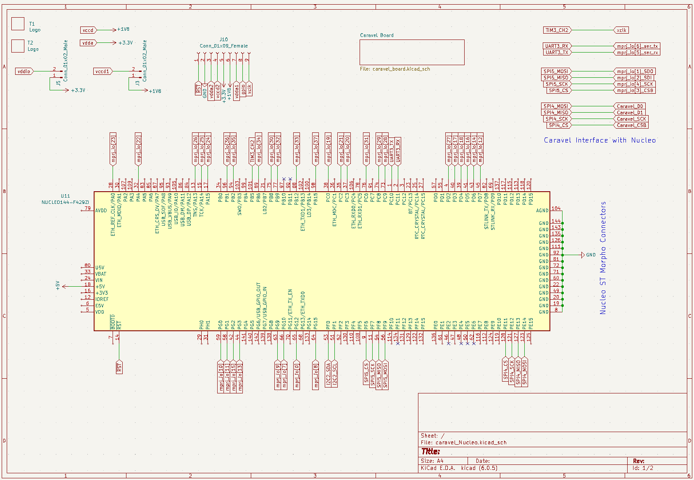
Caravel + Nucleo Board Schematic

Slide 16
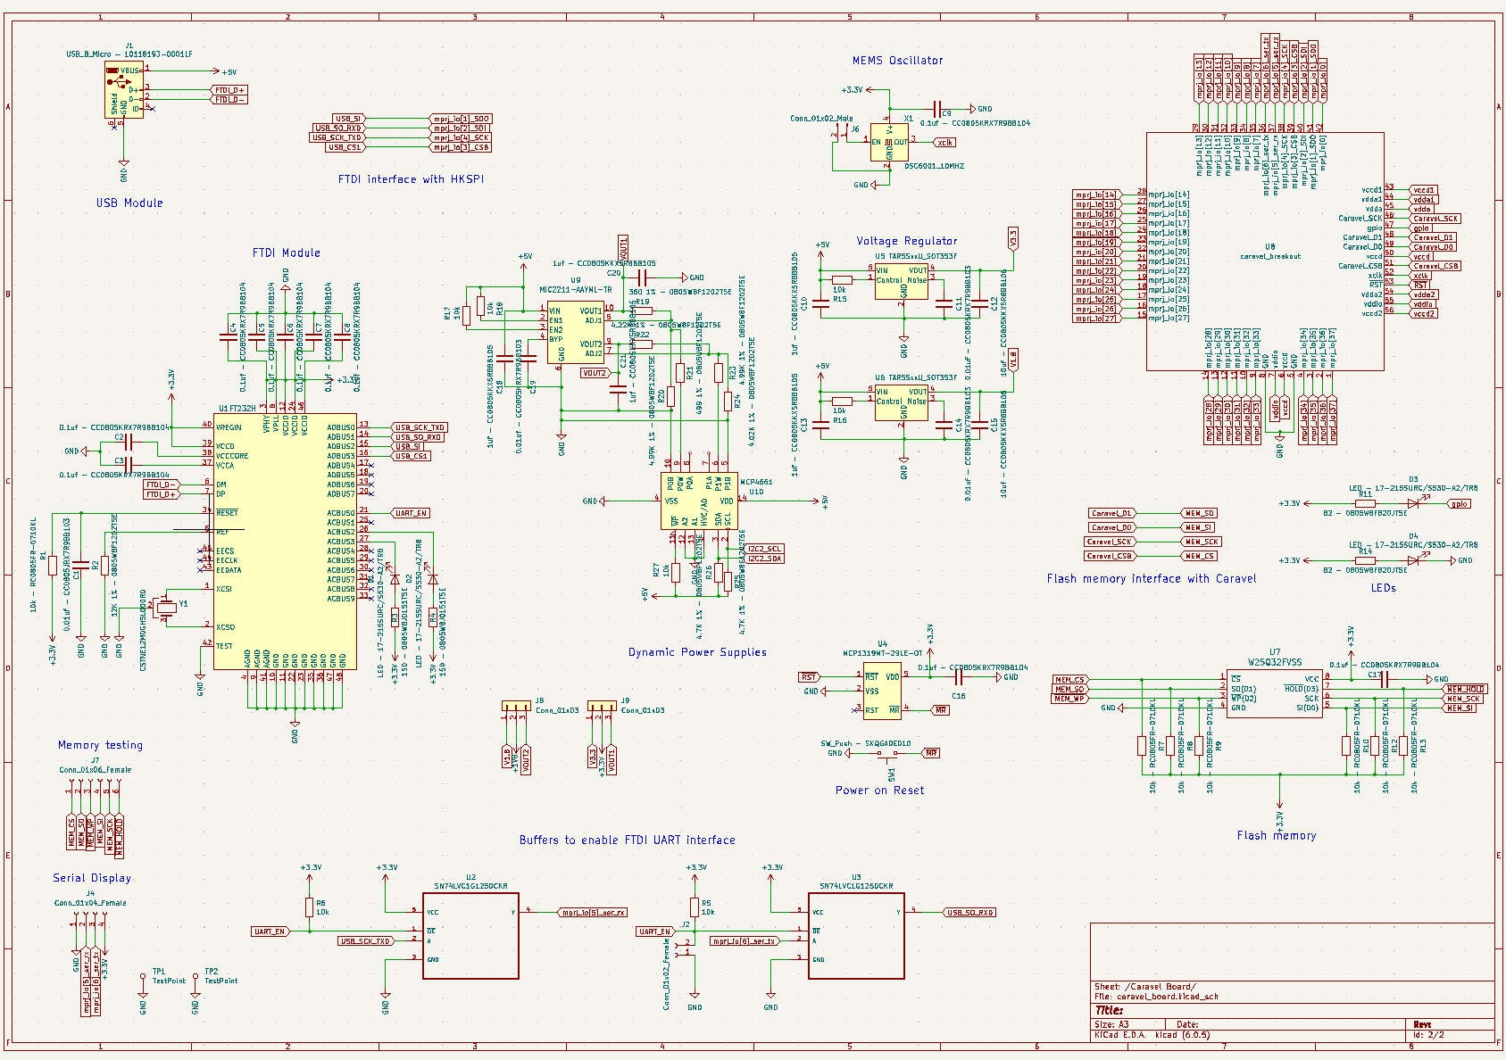
Caravel + Nucleo Board Schematic

